Slide 1
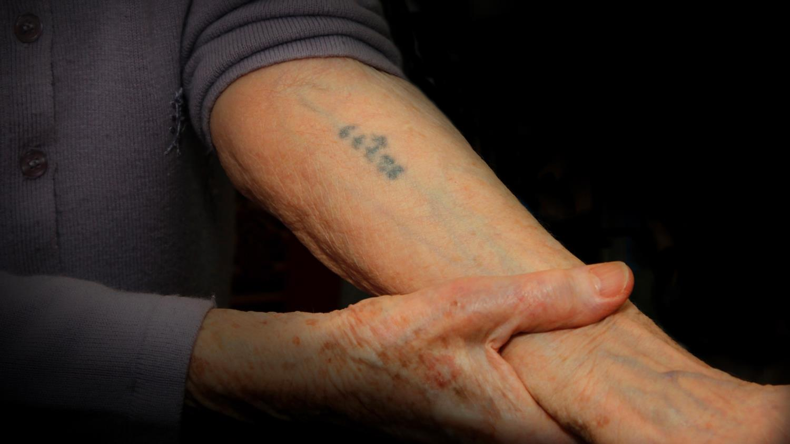
BLUE TATTOO

Slide 2
BLUE TATTOO
Dina’s Story

Slide 3
BLUE TATTOO
Dina’s Story
Joe’s Song

Slide 4
The Holocaust most commonly refers to the
attempted extermination of the Jewish People of
Eastern Europe, primarily between 1941-1945, as envisioned and perpetrated by Adolf Hitler, founder
and leader of Germany’s Nazi Party.
Others killed during this period included
Poles and Roma (Gypsies).

Slide 5
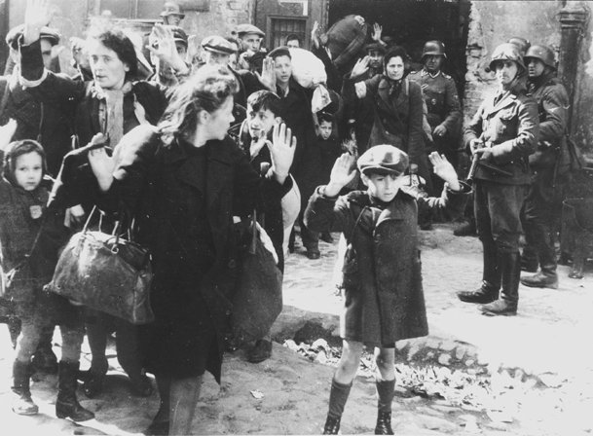
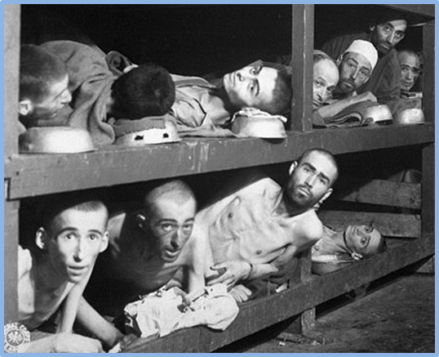
Families were rounded up, separated and sent to concentration camps where they were either gassed to death, died from starvation or forced into hard labor.

Slide 6
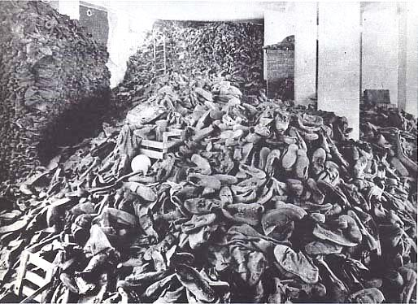
By the time Germany was defeated by
the allies in WWII, six million Jewish men women
and children had been murdered.

Slide 7
Many of those who survived emigrated to
countries such as America where they were able
to make new lives for themselves.
As difficult as it was for them to relive their nightmares, many survivors knew they had to tell their stories,
so the world would learn and never forget.

Slide 8
Dina Rosenberg Jacobson
of Elmira NY was one such
survivor. As a teenager in Poland,
she was sent to Auschwitz, the
most brutal of the death camps…

Slide 9
Dina Rosenberg Jacobson
of Elmira NY was one such
survivor. As a teenager in Poland,
she was sent to Auschwitz, the
most brutal of the death camps…
…simply because she was Jewish.

Slide 10
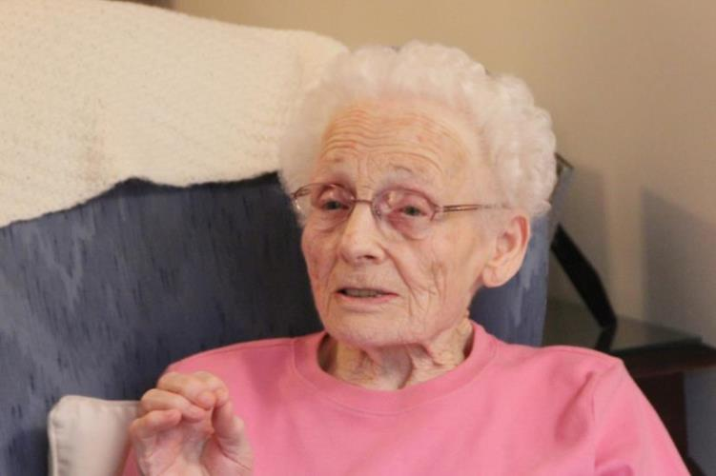
By the time she was liberated in 1945, Dina had
spent three horrific years in Auschwitz.
.
Dina, 65 years later at her home in Elmira NY

Slide 11
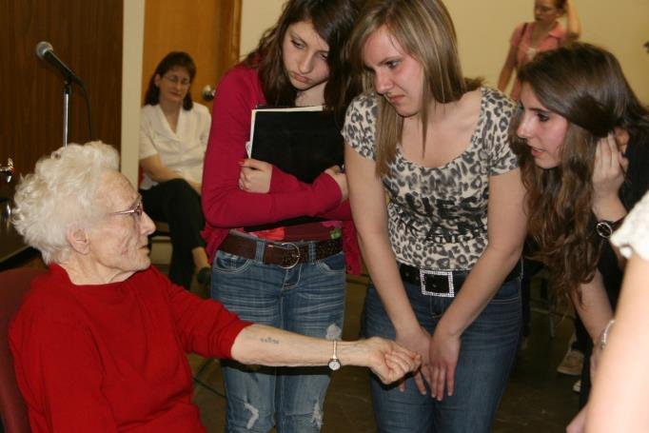
Despite having to recall painful memories, Dina devoted years of her life speaking to students about the Holocaust
at schools throughout NY’s Southern Tier
Dina showing Vestal High School students the tattoo given to her by the Nazis for identification purposes.

Slide 12
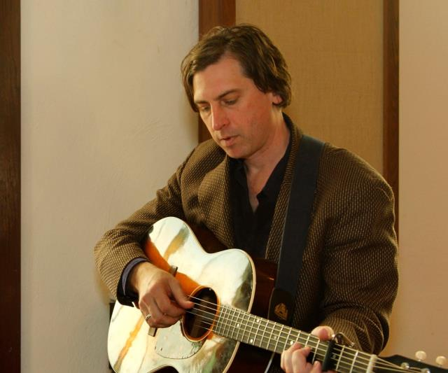
A nationally renowned folksinger from Ithaca NY heard about Dina and wanted to meet her.
Joe Crookston

Slide 13
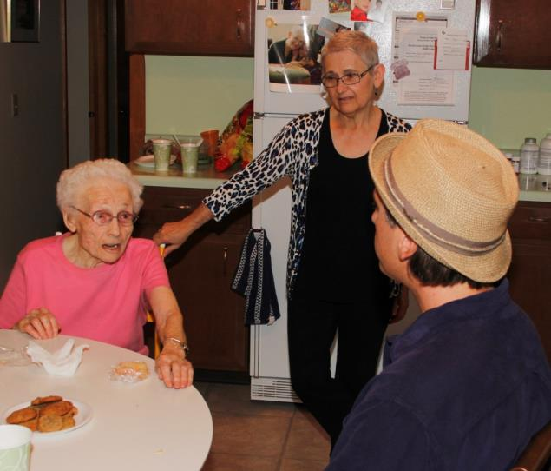
Together with Dina’s daughter, Connie,
they met at her house in Elmira.

Slide 14
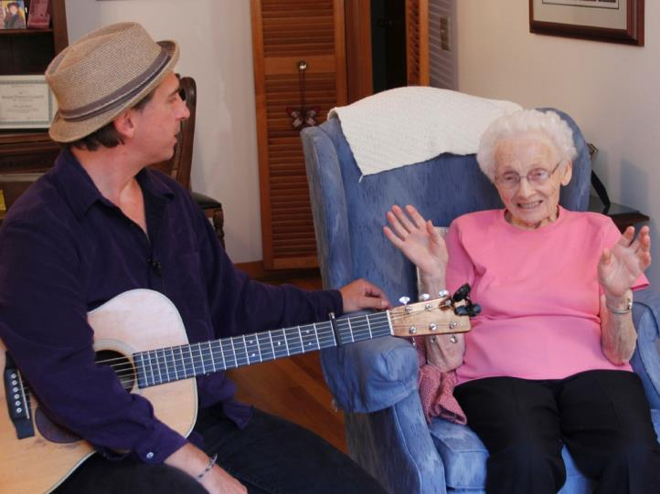
He would write a song that captured the essence
of her life as a Holocaust survivor.
“Blue Tattoo”

Slide 15
Together they would develop
A common bond with a shared purpose

Slide 16
Together they would develop
A common bond with a shared purpose
To educate people about the Holocaust on a personal level

Slide 17
Together they would develop
A common bond with a shared purpose
To educate people about the Holocaust on a personal level
…that would motivate them to recognize the signs of genocide

Slide 18
Together they would develop
A common bond with a shared purpose
To educate people about the Holocaust on a personal level
…that would motivate them to recognize the signs of genocide
…and prevent it from ever happening again.

Slide 19
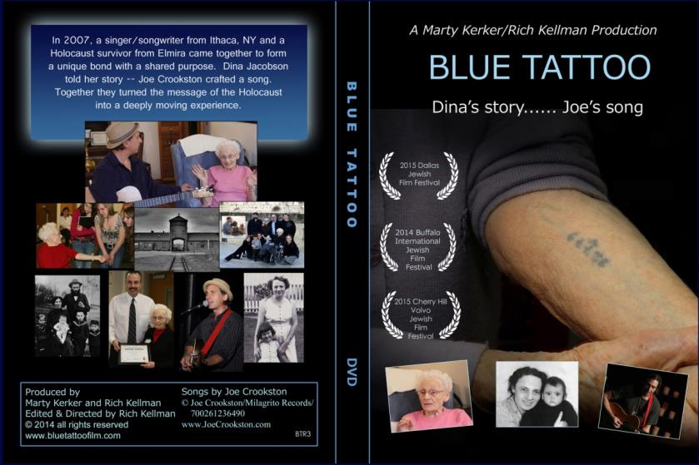
A film was made documenting how Joe’s song would
become a new and powerful “voice” for Dina’s story.
…
.
Blue Tattoo:
Dina’s Story, Joe’s Song
The version of the film you are about to see has been specially modified from the original.

Slide 20
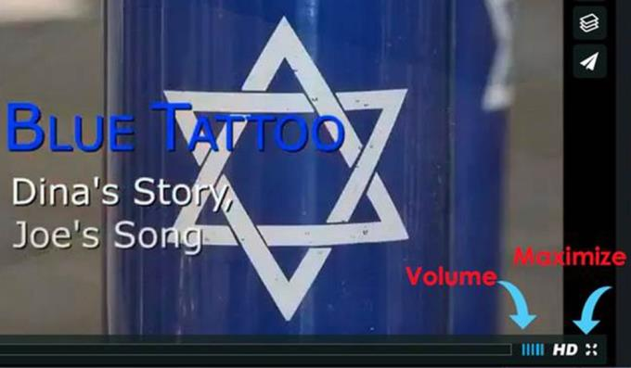
Instructions for Viewing The Film
Hover your mouse over the picture
on the left. When the icon
appears,
click inside the red border
and you will be directed to a link
on Vimeo for viewing.
Once on Vimeo, maximize the screen and adjust the volume
Toubleshooting Tips
Advance to next slide.

Slide 21
Troubleshooting tips
n If you get the message “an unexpected error has occurred”
wait 30 seconds, go back and try clicking again.
You must have PowerPoint 2010 or higher for the direct link to work.
If you are unable to get a direct link to Vimeo, you may
access the film by opening your web browser and entering
http://www.hrcbuffalo.org/blue-tattoo/
Advance to next slide after viewing the film

Slide 22
Discussion/Questions

Slide 23
The film began with a quote from Rudyard Kipling: “If history were taught in the form of stories, it would never be forgotten.” Do you think this is true? Why?
How does this quote relate to the film you just saw?
Why is it important that history not be forgotten?
Describe your thoughts on hearing a song or seeing a film about history rather than reading it in a textbook

Slide 24
The film talks about “survivors.” Give an example of a survivor.
Why is that a good word to describe Dina?

Slide 25
What does “identity” mean?
Who are the people and what are the things in your life that are important to you? How would you feel if all those people and all your possessions were suddenly taken away?
Concentration camp prisoners had numbers tattooed on their arms so they could be identified by the Nazis.
Why do you think they did this?
How would you feel if the people around you stripped you of your identity?

Slide 26
Why does the film end with the following quote by Holocaust survivor and author Elie Wiesel from his book Night: “I swore never to be silent when human beings endure suffering and humiliation.”
Describe a time when you or someone you know of spoke out against suffering and/or humiliation.
Explain how your action or the action of that other person might have made a difference.

Slide 27
ASSIGNMENT
The film and song Blue Tattoo encourages us to learn the lessons of the Holocaust so that it will never happens again.
After watching the movie/hearing the song, please
write a fictional “Letter to Dina” that includes
your thoughts on the following:
n Explain why learning about her story is important
Describe two lessons of the Holocaust you have taken away from that story.
n Convey anything else you would like to express to Dina or share with her on
a personal level

Slide 28
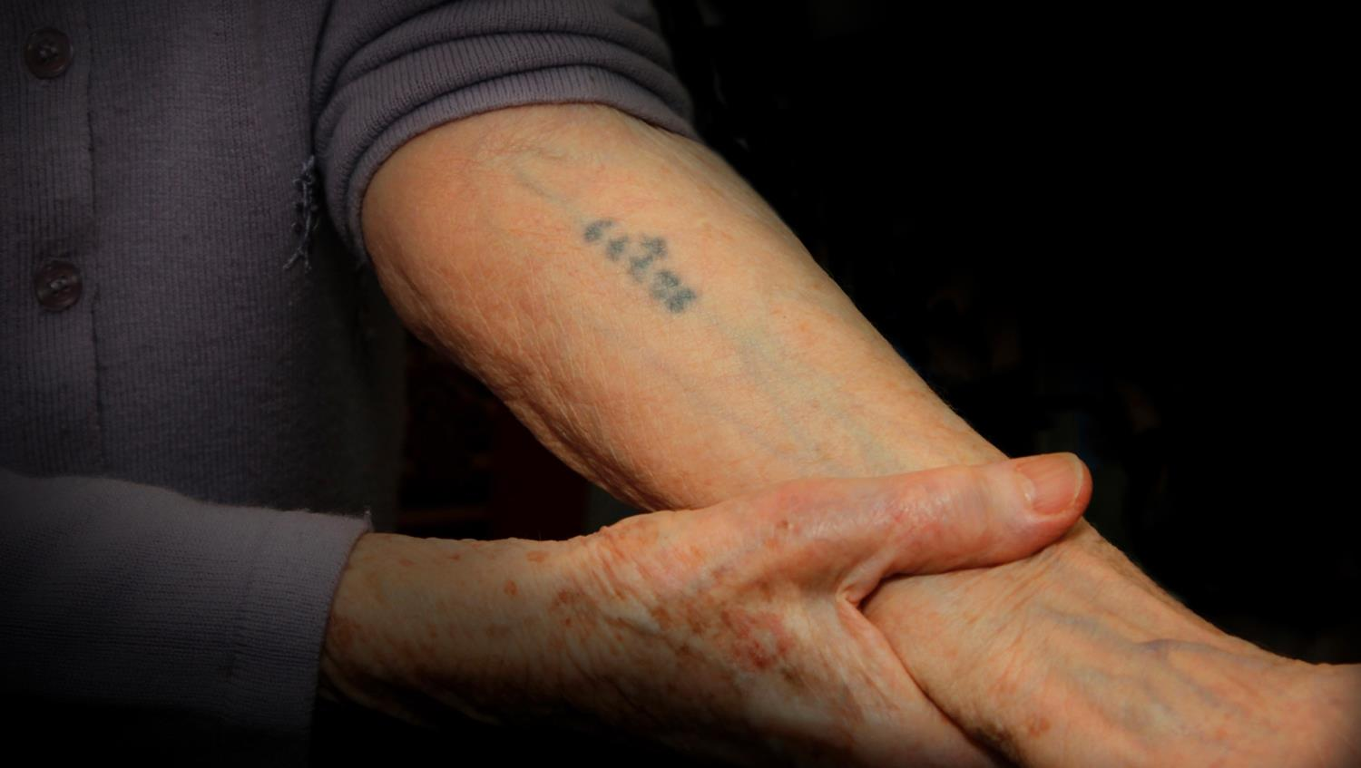
Blue TaTTOO: Dina’s Story, Joe’s Song
This Concludes the Educational Unit
This presentation has been provided to you by the
Holocaust Resource Center of Buffalo, NY www.hrcbuffalo.org
If you have any questions about this presentation or would
like to order the full length version of the film on DVD,
please contact the film producers, bluetattoofilm @gmail.com
Thank you to those individuals who graciously appeared in
the film, and to students and teachers for understanding
the need to remember and learn from history.

